Slide 1
Natural Gas Liquids
Group 9 Members
Tabbicca Beatrice
Seshie Christopher
Quist Jeffrey
Amankwatia Anthony O

Slide 2
What is natural gas ?
Natural gas is a gas consisting primarily of methane, typically with 0-20% higher hydrocarbons (primarily ethane).

Slide 3
What is natural gas liquids?
Natural Gas Liquids or "NGL" are those hydrocarbons in natural gas that are separated from the gas as liquids through the process of absorption, condensation, adsorption, or other methods in gas processing or cycling plants.

Slide 4
Constituents of natural gas liquids
Typically, these liquids consist of propane and heavier hydrocarbons and are commonly referred to as lease condensate, natural gasoline, and liquefied petroleum gas.
They also include natural gas plant liquids (primarily ethane, propane, butane, isobutane, and lease condensate (primarily pentanes produced from natural gas at lease separators and field facilities.

Slide 5
Sources of ngl
Natural gas liquids are usually obtain from natural gases.
Therefore its sources are from that of natural gases which are Fossil natural gas, Town gas, Biogas and Crystallized natural gas – Hydrates.

Slide 6
Fossil natural gas
Fossil natural gas can be "associated" (found in oil fields) or "non-associated" (isolated in natural gas fields), and is also found in coal beds (as coalbed methane).
Town gas
Town gas is a synthetically produced mixture of methane and other gases, mainly the highly toxic carbon monoxide, that can be used in a similar way to natural gas and can be produced by treating coal chemically.
Biogas
When methane-rich gases are produced by the anaerobic decay of non-fossil organic matter (biomass), these are referred to as biogas (or natural biogas).
Crystallized natural gas - Hydrates
Huge quantities of natural gas (primarily methane) exist in the form of hydrates under sediment on offshore continental shelves and on land in arctic regions that experience permafrost such as those in Siberia (hydrates require a combination of high pressure and low temperature to form).

Slide 7
Production of ngl
The block flow diagram also shows how processing of the raw natural gas yields by-product sulphur, by-product ethane, and natural gas liquids (NGL) propane, butanes and natural gasoline (denoted as pentanes +).

Slide 8
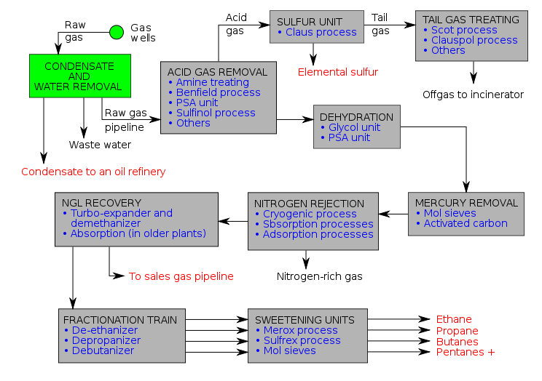

Slide 9
Some processes in the production of ngl
Acid Gas Removal
Dehydration
Mercury Removal
Nitrogen Rejection
NGL Recovery
Fractionation Train
Sweetening Unit

Slide 10
Mercury Removal
Mercury is often present in natural gas, petrochemical and some refinery feed streams.
The processes involved in mercury removal are Mol sieves and Activated Carbon.

Slide 11
Nitrogen Rejection
In natural gas processing, the process of Nitrogen Rejection removes nitrogen, an impurity from a gas by liquefaction and regasification of the natural gas stream.
For larger applications, cryogenic gas processing is the standard and for smaller volumes of natural gas, a system utilizing Pressure Swing Adsorption (PSA) is the more typical method of removing nitrogen.

Slide 12
NGL Recovery
NGL-recovery is a unit for recovering ethane and heavier components (“ethane plus”) or propane-plus hydrocarbon components.
The NGL-recovery tower consists of two sections: The lower section is for ethane rejection and rough NGL fractionation; the top section is for methane separation

Slide 13
Fractionation Train
NGL, or natural gas liquids fractionation plants purpose is to separate the mixed natural gas liquids stream into separated products. These natural gas liquids that are separated by heat at NGL Fractionation plants include; ethane, propane, normal butane, isobutane and natural gasoline.

Slide 14
Sweetening Unit
In this unit, sweetening processes oxidize mercaptans into more innocuous disulfides, which remain in the product fuels.
Its process are Merox, Sulfrex and Mol sieves.

Slide 15
Storage and transportation
Natural gas liquids usually have to be moved long distances from their site of production to areas where they are in high demand.
The transportation system for natural gas liquids consists of a complex network of pipelines, designed to quickly and efficiently transport these liquids from their origin to areas of high demand.
Natural gas liquids are mostly stored in tanks and cylinders which are usually used for domestic and industrial purposes.

Slide 16
Environmental effect of ngl
Inhalation of NGL like butane can cause quite a number of health problems (eg.euphoria, drowsiness, asphyxia, frostbite, etc )
Butane is one of the most commonly misused NGL in the U.K and caused 52% of solvent related deaths in the year 2000.
Propane also causes a risk of explosion and fire. Thus making it generally unsuitable for use as fuel in boats.

